Slide 2
Digital Forensics Lecture-24
By- Dr.subhranil Das
Assistant Professor
School of computer Science

Slide 3

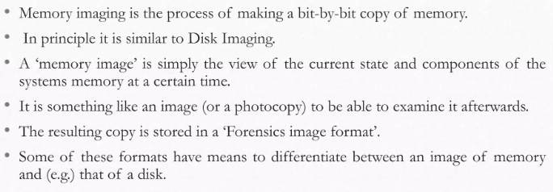
Memory Imaging

Slide 4
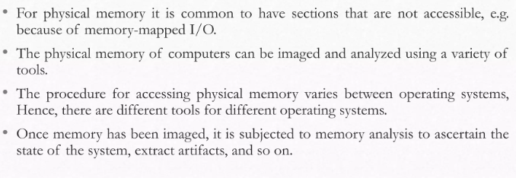
Memory Imaging

Slide 5
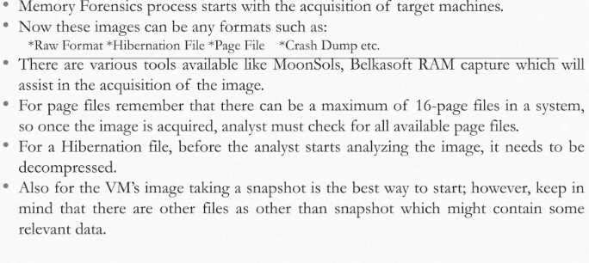
Memory Forensics Process

Slide 6
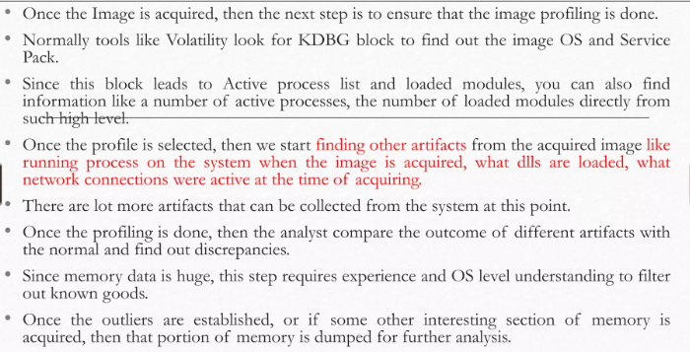
Memory Forensics Process

Slide 7
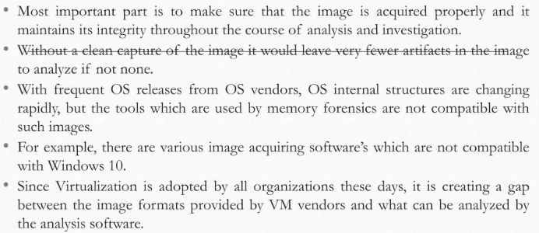
Challenges in the Memory Forensics

Slide 8
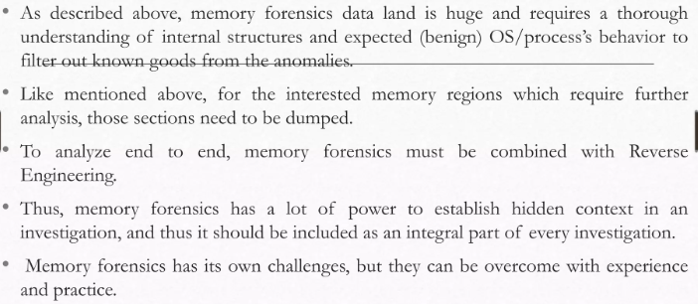
Challenges in the Memory Forensics

Slide 9
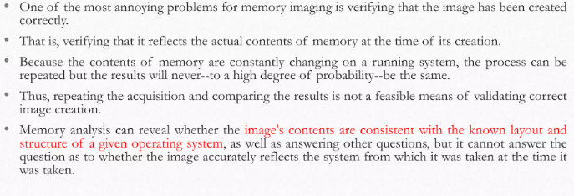
Practical Issue

Slide 10
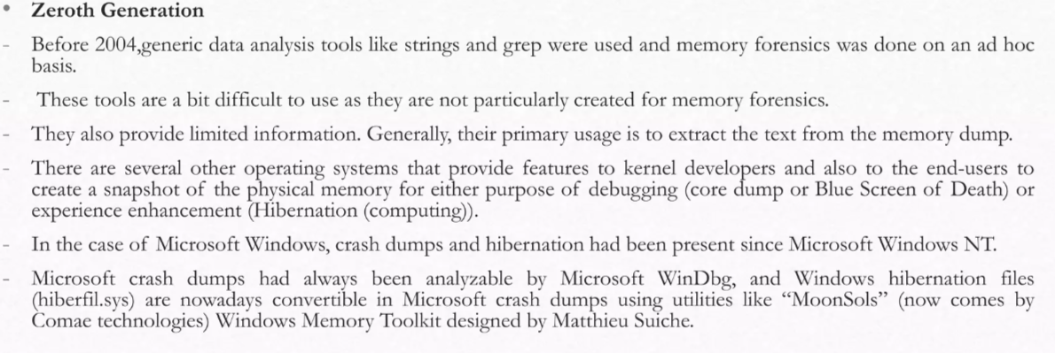
History and Background of Memory Forensics

Slide 11
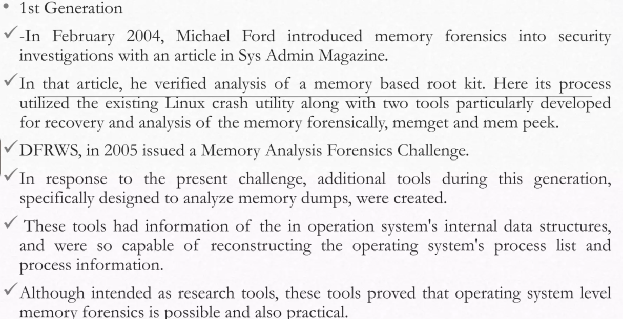
History and Background of Memory Forensics

Slide 12
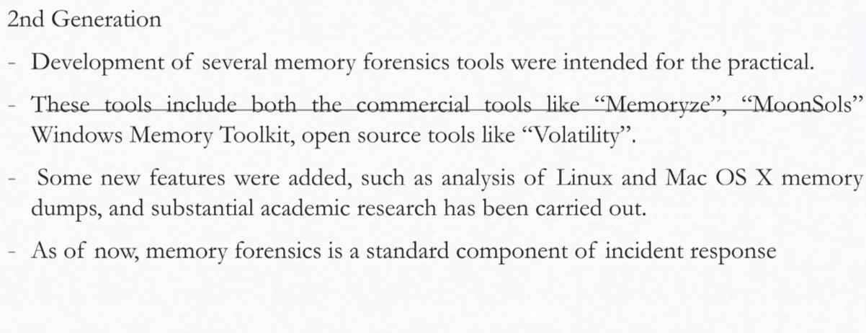
History and Background of Memory Forensics

Slide 13
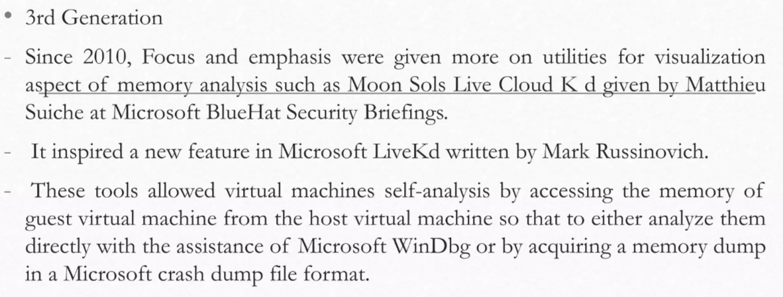
History and Background of Memory Forensics

Slide 14
Next Lecture
Memory Imaging Processing
.

